Slide 1
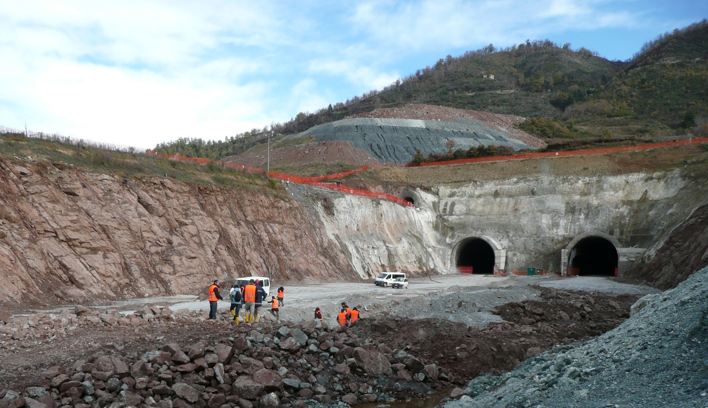
Avviso di Seminario
Overview on innovations in geotechnical engineering
Prof. Tiago Miranda
Civil Engineering Department of University of Minho (Portugal)
Il seminario si terrà presso l’Università Roma Tre
Dipartimento di Ingegneria - via Vito Volterra, 60, Roma
Lunedì 7 novembre 2022, Aula N20 ore 9:00-11:00

Slide 2
“Overview on innovations in geotechnical engineering”
Argomenti del seminario
In this lecture Professor Tiago Miranda will briefly present the research works he has been involved in his more than 20 years of activity as a researcher in the field of Geotechnics.
Afterwards, the lecture will focus on two topics, namely “Remote sensing techniques for rock slope characterization and monitoring” and “Geostatistics in rock mass modelling for underground structures”.
Recently remote sensing techniques including laser scanning, photogrammetry and satellite images have been used in the context of geotechnical engineering, for instance in the context of rock mass characterization and geotechnical monitoring. Some aspects of the potential of these techniques will be addressed in the context of slope stability, including the analysis of the impacts of earthquakes in this type of geotechnical structures.
Geostatistics is a probabilistic technique that was firstly developed in the scope of mining engineering and recently have been used in the context of geotechnics due to its ability to explicitly model complex geological conditions. In this presentation, some works related with the use of geostatistics to model heterogeneous rock masses will be presented.
The lecture will be more informative than specialized so that it can be interesting even for students not familiar with the addressed topics.
Relatore
Tiago Miranda is Assistant Professor of the Civil Engineering Department of University of Minho in Portugal. He has more than 20 years of experience in research and teaching in Geotechnics. He is coauthor of more than 200 publications and participated in sveral research projects.

